Slide 1

A Study of a Winning Tennis Streak
Sports Analytics Project
12/06/2022 - Max Terouanne, Victor Perroux, Theau Pihouee

Slide 2
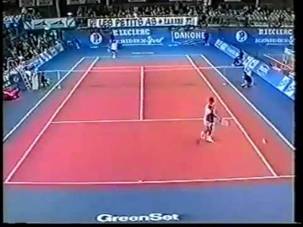
Where it all began...
1999: Gasquet beats Nadal in Junior World Championship
23 years later: 18-0 for Nadal against Gasquet
Luck or Skill?
Notes:
Little Champions tournament held in Tarbes, France
World championship for the 12-14 age range
Gasquet and Nadal were two young prodigies promised for great tennis careers
Gasquet v Nadal quarterfinals in 1999 where Gasquet won and ended up winning the tournament
However, 23 years later, winning record of 18-0 for Nadal against Gasquet
Luck or skill ?
Let’s investigate
(logique de la slide mieux reformuler)

Slide 3
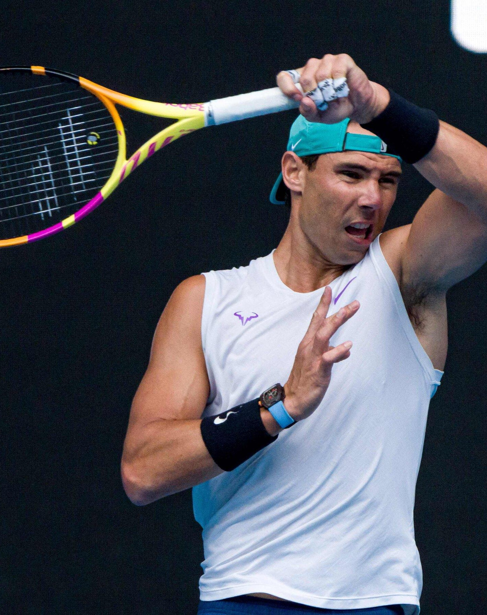
Agenda
Winning Streaks Overview
SRS Model
ELO Model
Performance Comparison
Simulation of Nadal vs. Gasquet matches
Comparison to Gasquet’s style players
Notes:
Focus on the study of two different models : the SRS and ELO models
Select the best performing one to run Monte Carlo simulations
Conclude about luck v skill

Slide 4
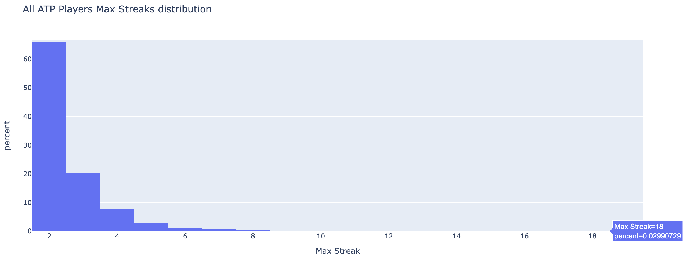
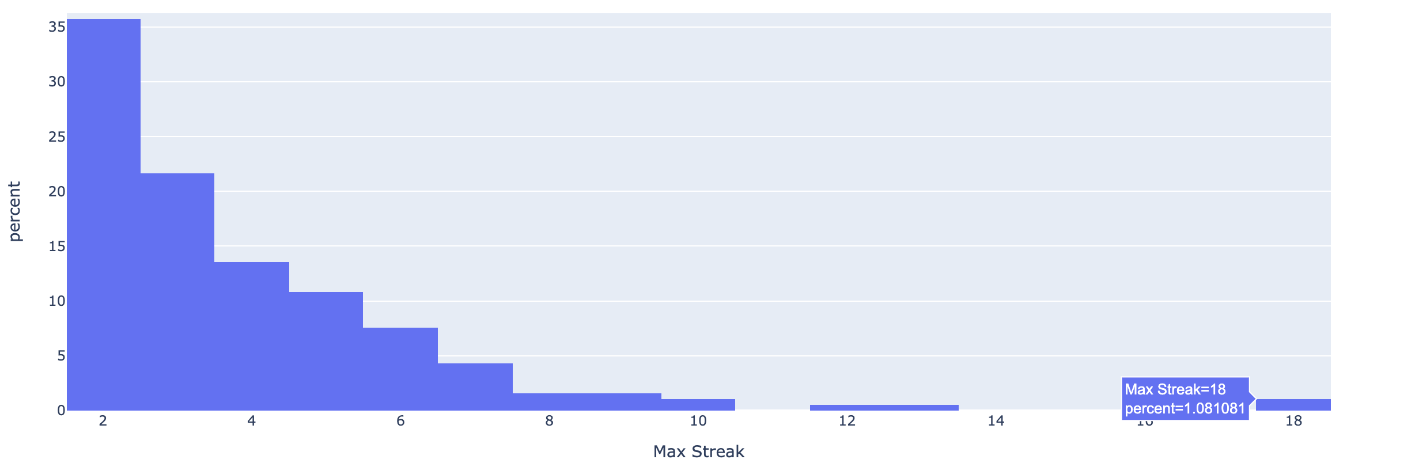
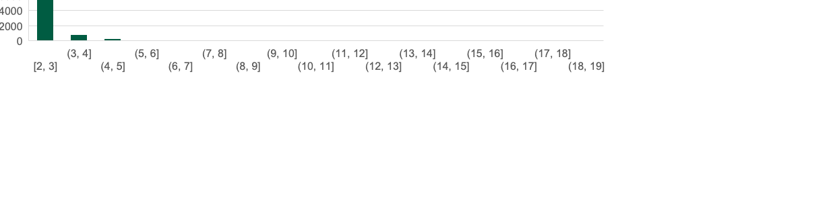
The first hypothesis is that Nadal-Gasquet streak is highly unlikely
All ATP Players Max Winning Streaks against all their Opponents
All Nadal’s Max Winning Streaks against all his Opponents
How do we check this hypothesis and measure luck vs. skill?
Notes:
Look at max winning streaks
Exceptional case of nadal v. Gasquet
Heavier tail for Nadal
Hypothesis of streakiness
Measure luck and skill
A first step in our study was to look more closely at the ATP data and process it to compute winning streaks between all ATP players pairs.
It was a first way to visualize the exceptional aspect of Nadal’s nonending winning streak against Gasquet.
Here you can see an overview of how Nadal does compared to ATP Players.
On the top plot, you can see a histogram of maximum winning streaks for every player against all their opponent during their career.
The same is plotted underneath but for the special case of Nadal. As we expect an exceptionally good player such as Nadal, his max win streak distribution has a heavier tail than the global distribution.
From the observation that a max winning streak of 18 matches in the ATP Tour is only 0.03% of all max winning streaks, we want to check this highly unlikely hypothesis and come up with a measure of luck vs. skill in this particular case.

Slide 5
SRS and ELO models will be used to quantify the likelihood of this streak
Rating for the two players
Probability of the outcome of the match
Monte Carlo simulations
Rating all the ATP players on the circuit
Using two different models: ELO Model and SRS Model
Compare their performances and choose the best one
First, compute the probability of winning a point depending on the ratings of the two players
Deduce the probability of winning a tie-break, a set and then a match
Computation of a 18 matches streak for several players
Iterating the simulation 1000 times for each pair of players
Conclude about the likelihood of such a streak

Slide 6
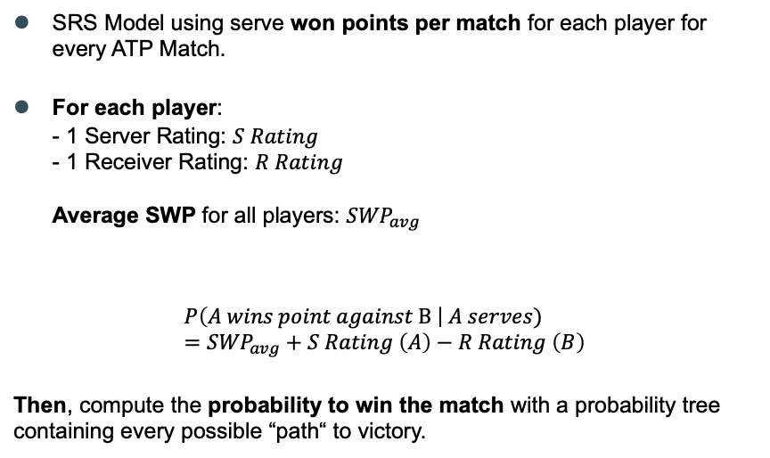
SRS model gives inconclusive results due to lack of data
Hypothesis and building of the model
Outcomes of the model
Server | Rating
Thanasi Kokkinakis | 0.3056
Maximilian Marterer | 0.1271
Feliciano Lopez | 0.1051
Juan Martin del Potro | 0.1049
Jiri Vesely | 0.0979
Top 5 server rankings in 2019
Receiver | Rating
Thanasi Kokkinakis | 0.3056
Juan Martin del Potro | 0.1200
Maximilian Marterer | 0.1184
Rafael Nadal | 0.1041
Feliciano Lopez | 0.1036
Major challenge regarding the data: not many charted matches available
Solution found: extrapolate the number of points won with linear regression using the match final score and the available charted matches.
Top 5 receivers rankings in 2019
Notes:
Particular SRS with serving won points
2 ratings and SWP 🡪 probability to win a point and from there a match
Main difficulty: lack of data
Inconclusive results as we can see
We used a SRS model taking serve won points into account to quantify each player’s serving and receiving strength.
Each player ends up having both a S rating and R rating and we also know the average Serve Winning Percentage of the ATP tour.
The model is fitted on every ATP match of a season with the number of points won by each player when they serve against the opponent
We can then infer a probability of winning a point conditioned by the fact that a player is serving or not; and we can do this for every pair of player, even those that did not play against each other this year.
The major difficulty we faced to do this method well is the lack of data on the matches; we indeed have all the scores since ther 1920s but we do not have that many matches that are more precisely charted with the number of points per server and receiver.
A first try with the few matches gave inconclusive results.
Our way around was to extrapolate the number of points won per server by doing a regression between the match final score and the matches we indeed had charted.
This did not however give very satisfying results in the end as you can see the top ranking for 2019 where, apart from Nadal, we do not expect these players to be present.
Point par point. Nécessite de connaitre pour chaque match le SWP et le RWP. Détailler un peu plus le fonctionnement.
Matchs chartés manuellement. Peu de matchs dans la base de données et biais car seuls les matchs des meilleurs joueurs sont chartés (pas représentatif) donc impossible d’avoir des ratings pour beaucoup de joueurs + les ratings qu on a pour les joueurs restants sont biaisés
On a pas toujours accès aux détails point par point mais on a accès aux scores des matchs. Solution à ce problème = régresse le nombre de point gagnés au service pour chaque joueur à partir du score du match
Permet d’enrichir la base de données complétement et d’appliquer le modèle SRS.

Slide 7
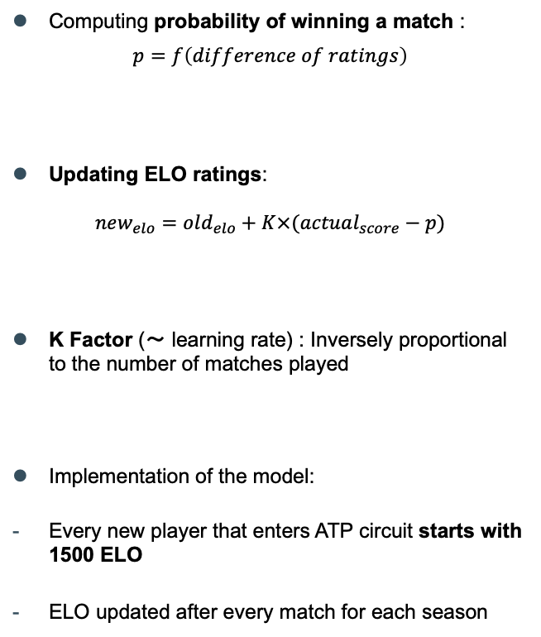
ELO model seems to better match actual performances
Hypothesis and building of the model
Outcomes of the model
ELO Ranking | Player Name | ELO Ratings
1 | Rafael Nadal | 2281
2 | Roger Federer | 2250
3 | Novak Djokovic | 2248
4 | Robin Soderling | 2123
5 | Stefanos Tsitsipas | 2122
6 | Daniil Medvedev | 2104
Top 6 ELO-rated players in 2019
ATP Ranking | Player Name | ATP Points
1 | Rafael Nadal | 9985
2 | Novak Djokovic | 9145
3 | Roger Federer | 6590
4 | Dominic Thiem | 5825
5 | Daniil Medvedev | 5705
6 | Stefanos Tsitsipas | 5300
Top 6 ATP players in 2019
Notes:
Three main components :
=> probability of winning. The bigger the difference, the higher the proba of winning for the best rated player
=> update the elo : compares the proba given by our model to the real outcome (0 or 1). The closer our prediction is to the real outcome, the less we update (model works well already)
K factor, sort of learning rate. Inversely proportional to the number of matches played.
Implementation of the model
Looking at the results we obtain: very similar to ATP ratings. Seems to reflect actual players levels.
Let's confirm our intuitions by looking at the models' performances
Let's now focus on the ELO rating model.
There are three main components to understand when it comes to this model
First the probability of winning which depends on the difference of ratings between the two players. The bigger the difference, the higher the proba of winning for the best rated player
Then, how we update the elo, which compares the proba given by our model to the real outcome (0 or 1). The closer our prediction is to the real outcome, the less we update (our model works well already)
Finally, the K factor, a sort of learning rate, which appears in the previous equation. Inversely prop to the number of matches played. For example, if a player played a lot of matches, small K and we update the ELO only a little bit
Moving on to the implementation of the model :
- Every player starts with an ELO rating of 1500
- And updated after every match for each season
Looking at the results we obtain : very similar to ATP ratings. Seems to reflect actual players levels.

Slide 8
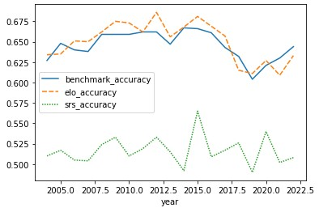
ELO model outperforms SRS and the benchmark
Benchmark v SRS v ELO
Benchmark : The player with the best ATP ranking is predicted to win. However, no win probabilities inferred
Yearly evolution of accuracy for the three models
Table summarizing models’ results
Model | Accuracy | Brier Score
Benchmark | 0.646 | -
SRS | 0.517 | 0.274
ELO | 0.650 | 0.220
ELO Model has a higher accuracy and lower Brier Score
compared to the other models
ELO Model is selected for the Monte Carlo simulations as it shows the best performances
Notes:
Let's now compare both of our models with a benchmark where the best ATP ranked player is predicted to win the match
For each season and model, we predicted the outcomes of matches, compared that to actual outcomes, and aggregated the results in the following table.
We notice a low accuracy for SRS (close to random choice) => No predictive abilities
Close accuracy for benchmark and ELO around 65% but slightly higher for ELO
Overall, higher accuracy and lower brier score for ELO
So we choose the ELO model to run our Monte Carlo simulations as it replicates the real match winning probabilities the best

Slide 9
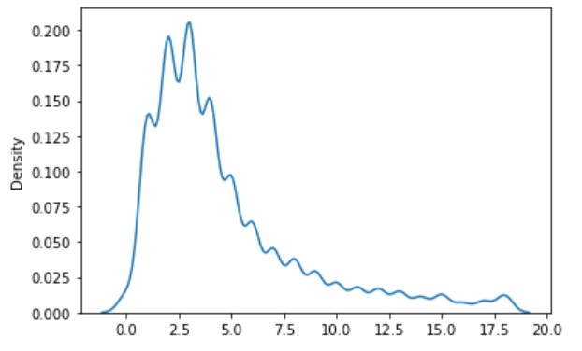
After simulations, Nadal v Gasquet streak seems to combine a lot of luck and skills
Computing streak probabilities for 18 matches series
Null hypothesis of no streakiness: all ordering of confrontations between two players are equally likely. The outcome of a match has no impact over the outcome of the next one.
Probabilities are easily evaluated with Monte Carlo simulations
We computed the confrontations between 10 players (90 combinations)
For each combination, we run 1000 simulations
Percentage of simulations where max streak is 18: 1.16 % (p-value)
Very unlikely under independence conditions
Luck + lots of Skill

Slide 10
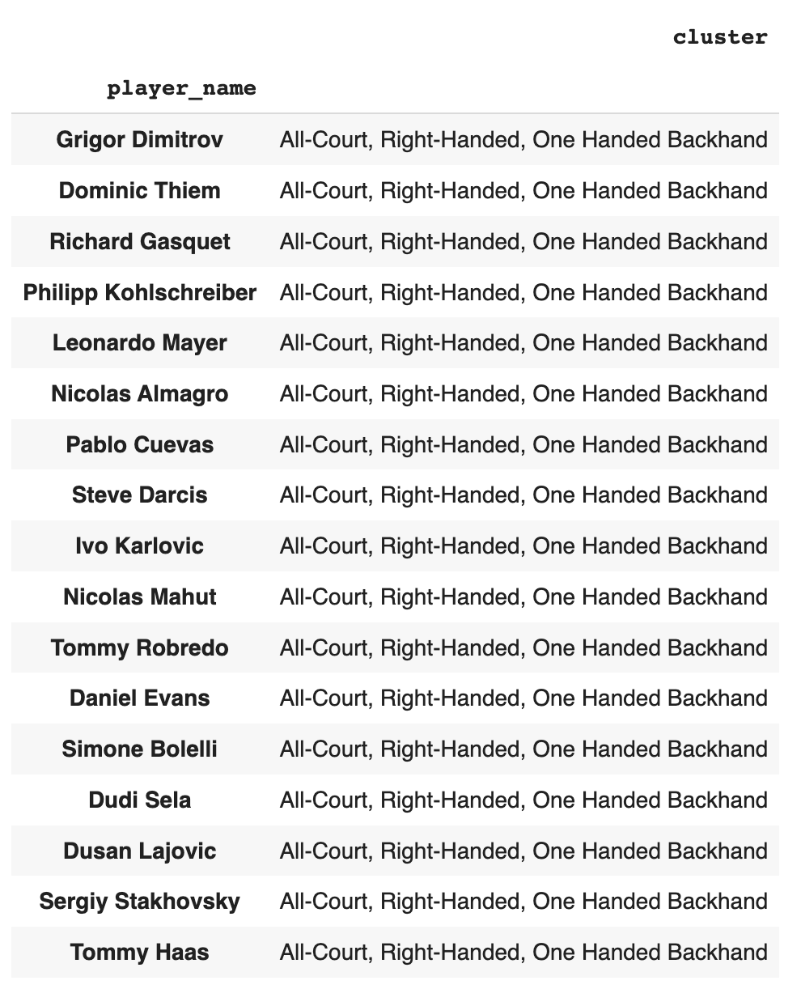
The « skill » can be explained by a compatibility of styles of Nadal and Gasquet
 | Nadal’s Win Percentage
Whole Career | 83.0%
Against Players from Gasquet’s Cluster | 91.0%
 | Nadal’s Max Streak Average | Nadal’s Max Streak Median
vs. All ATP Players | 2.69 | 2
vs. Players from Gasquet’s Cluster | 5.53 | 5
vs. Rest of ATP Players | 2.53 | 2
Notes:
Explain skill by clustering
Gasquet’s style of playing
Better than avg performance against this cluster: explain part of the high amount of skill required
The importance of skill by Nadal in this impressive winning streak can be observed by looking at his performances against clusters of players.
Based on several sources that previously performed ATP players clustering, we used these clusters to see if Nadal performed particularly well against players with a similar style to Richard Gasquet.
On the left, you can see the group identified as a cluster of Richard Gasquet: they all share some key characterisitics in their style of playing: all-court players, right-handed with a one handed backhand.
Now, when we compute Nadal’s win percentage and winning streaks against those players, we indeed observe a important difference compared the overall ATP tour. This allows us to conclude that Nadal is particularly good against players like Gasquet and it explains part of the high amount of skill required to win 18 times in a row against the Frenchie.
We clustered the tennis players on the circuit according to several criteria
Left-handed, right-handed
All court, Puncher, Big Serve, Volleyer

Slide 11
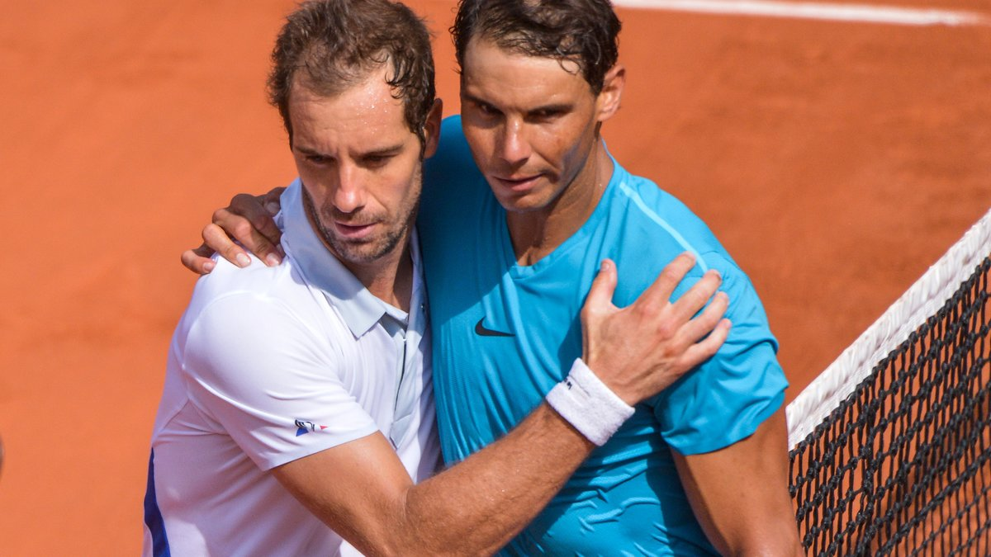
Thank you for your attention!

Slide 12
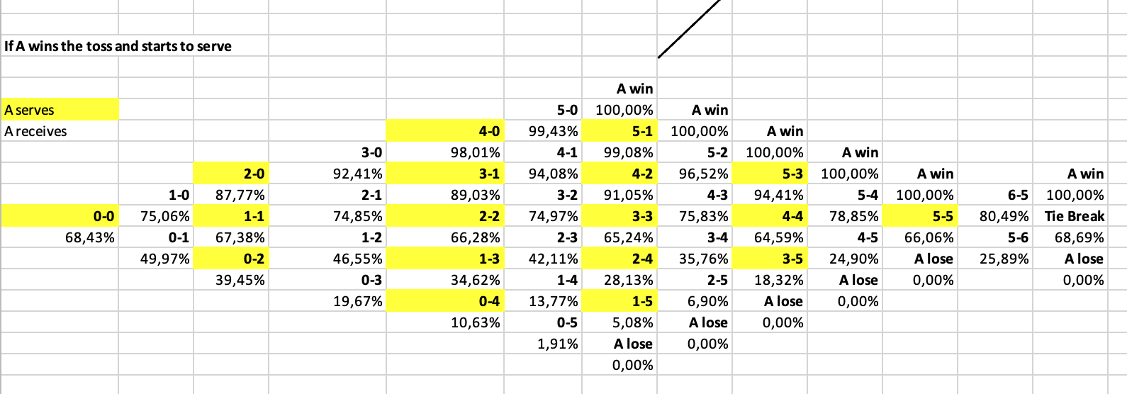
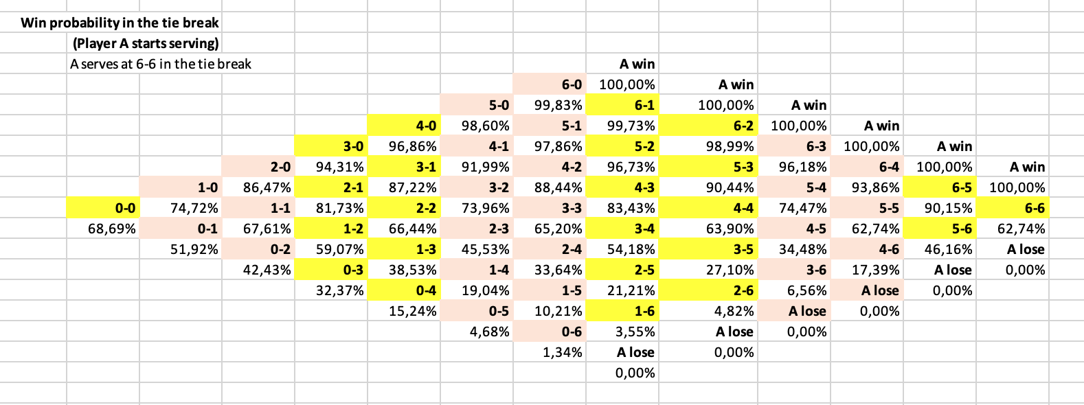
Appendix

Slide 13
